Slide 1
Specification Document for Product Billed-Claim Submission

Slide 2
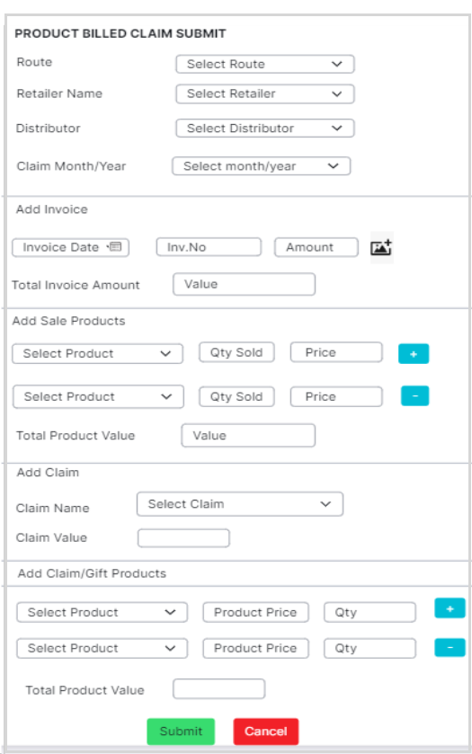
Product-Billed Claim Submission Screen:

Slide 3
Product Billed- Claim Submission:
Objective : To enable the field users to submit claim according to the bill/invoice value of the selected sale products.
Function:
When we click the ‘Product Billed’ module, the Product Billed Claim submit screen should open.
Regression Note:
To submit claims under Product Billed module, the Product Billed claim and Gift/claim products should be created in Admin web first.
Product Billed - Claim Submit Screen:
The ‘Product Billed’ claim submit screen should have the following fields,
1. Route (mandatory) - Single Select dropdown list with search option
Objective - To select the route.
Functions:
On clicking the list,it should display all the route available under the Field force HQ.
After selecting the route, the route name should be displayed in the field.
Validations:
After selecting the route,it should allow to choose a different route name.
Search bar should lookup the correct route name if we search words from either Beginning, Middle or end.

Slide 4
2. Retailer Name (mandatory) – Single Select dropdown list with search option.
Objective - To select the Retailers names,for whom the order was taken.
Functions:
On clicking the dropdown box,should display all the retailer names according to the selected route.
Should display the selected retailer name in the field.
Validations:
When the route name is changed, the retailer name field should be cleared.
After selecting a retailer,it should allow to choose a different retailer name.
Search bar should lookup the correct retailer name if we search words from either Beginning, Middle or end.
3. Distributor Name (mandatory) - Single Select dropdown list with search option.
Objective - To select the distributor name.
Functions:
Should display all the distributor names according to the selected route.
Should display the selected distributor name in the field.

Slide 5
Validations:
After selecting the distributor name,it should allow to choose a different distributor.
Search bar should lookup the correct distributor name if we search words from either Beginning, Middle or end.
4. Claim Month/ Year (mandatory) – Single select list box.
Objective - To select the month for which claim is to be submitted.
Functions:
On clicking the dropdown,it should show all ACTIVE claims for the current month.
Validations:
When the claim month is changed,all the invoice fields should be cleared automatically.
5. Add Invoice (mandatory) – Label
5.1 Invoice Date – Calendar
Objective - To select the date of invoice.

Slide 6
Validations:
Should allow to select invoice date only from the month selected in Claim Month/Year field.
Selected Date should be displayed in the field.
Should not allow to select the date if the Claim Month/Year field is empty.
5.2 Invoice Number – Textbox
Objective - To enter the bill/invoice number.
Validations:
Should allow max of 30 characters.
Should allow alphanumeric characters.
Should allow special character ( - ) only.
5.3 Amount – Number box
Objective - To enter the bill/invoice amount.
Validations:
Should allow max of 12 digits.
Should not allow characters.
Should not allow values less than 1.
Should allow decimal values and only 2 digits after decimal point.

Slide 7
5.4 Total Invoice Value – Number box.
Objective - To display the total invoice amount .
Function:
After entering the invoice date,number and invoice amount,the ‘Total Invoice Value’ field should add all the invoice amount and display the result.
Validation:
Should not allow to edit the value.
5.5 Invoice ‘+ ‘ and ‘- ‘ - Buttons
Objective – To add or delete more than one bill/invoice.
Functions:
+ Button – When the button is clicked, it should display the Date , Invoice no. and amount fields to add one more invoice/bill.
- Button – When the button is clicked, it should delete the added Date , Invoice no. and amount fields.

Slide 8

Regression Note:
While creating the product billed claim,only if the ‘Split Up Needed’ option was set to ‘Yes’ there should be an add button ‘ +’ for invoice.
If the ‘Split Up Needed’ option was set to ‘No’,then there should be no ‘+’ button for adding second invoice.i.e. User should be allowed to upload only one bill/invoice image.
5.6. Upload Invoice - Button
Objective - To upload all the images of the Invoice/Bills.
Functions:
On clicking the button, the following options must pop up for image selection,
Camera
Attach file
Close
While The Camera option, should open the mobile camera and allow the user to take pictures of the invoice. It should have a RETRY option to capture photo again and OK option to save the captured image.
Attach file option, should open the device “FILE MANAGER” and allow the user to select and upload images from the device.
Close option, should close the pop up box.
After capturing the invoice/bill image, Photo list screen should open.
After the invoice is attached,should be able to click and view the invoice image in a bigger size.

Slide 9
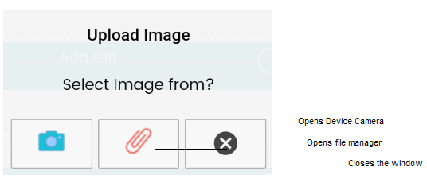
Reference Image:
5.7 Photo List Screen:
Objective – This screen should display the captured invoice image one by one. It has the following fields,
1. Title – Textbox
Objective - To enter the title of the image.
Validations:
Should allow max of 30 characters.
Should allow alphanumeric characters.
Should allow special characters.

Slide 10
2. Remarks - Textbox
Objective - To enter the remarks or any comments regarding the image.
Validations:
Should allow max of 150 characters.
Should allow alphanumeric characters.
Should allow special characters.
3. Delete - Icon
Objective - To delete the captured or attached image.
Function:
On clicking the icon,the captured image should be deleted and it should not appear again in the photos list.
4. Take Photo – Button
Objective - To capture the invoice image using device camera.
Function:
On clicking the button,the device camera should open and allow the user to capture bill image.

Slide 11
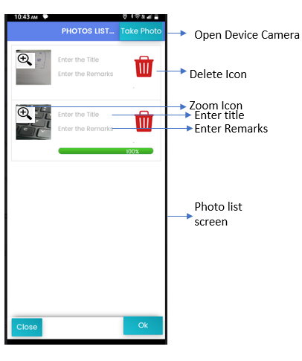
5. Zoom – Icon
Objective - To enable the user to enlarge and view the image.
6. Close - Button
Objective - To close the photo list screen without saving the changes.
7. Ok - Button
Objective - To save the changes made in the photo list.
Photo List Screen:

Slide 12
6. Select Sale Products - Label
6.1 Product - Single Select dropdown list.
Objective - To allow to select the sale product names.
Function:
On clicking the dropdown list,it should display all the selected product names from each category/brand or group.These products are selected in Product Brand/category/group field at the time of claim creation.(refer image).
Selected product name should be displayed in the field.
Validations:
Should allow to select only one product at a time.
Should not allow to choose already selected product name.(avoid duplicate entry).
Deactivated/Inactive products should not be shown in the list.
If any new product is selected in the claim creation screen,then it should be shown to the user in claim submission screen also.(after sync)

Slide 13
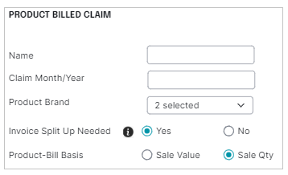
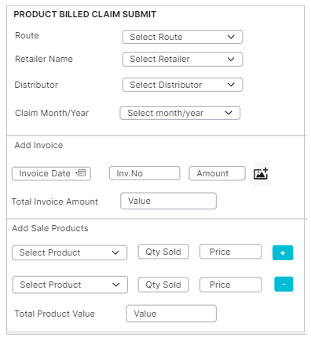
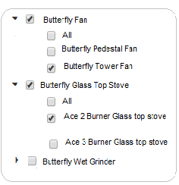
Flow:
Claim Creation Screen
Claim submission screen

Slide 14
6.2 Qty Sold – Number box
Objective -To enter how many units of products have been sold.
Validations:
Should allow max of 6 digits.
Should not accept values less than 1.
Should not accept characters and special characters.
Should not allow space before/after or between the digits.
Should not allow to enter decimal digits or floating values.
If the product name is changed,the data in ‘Qty field should automatically get cleared.
6.3 Price- Number box
Objective - To enter the price of the products sold from the bill/invoice.
Validations:
Should allow max of 6 digits.
Should not accept values less than 1.
Should not accept spaces in between digits,characters and special characters.
Should not allow decimal or floating values.
If the product name is changed,the data in ‘Price’ field should automatically get cleared.

Slide 15
6.4 Sale Products ‘+ ‘ and ‘- ‘ - Buttons .
Objective – To add or delete more than one sold products.
Functions:
+ Button – When the button is clicked, it should display the Product ,Qty Sold and amount fields to add one more sale product.
- Button – When the button is clicked, it should delete the added Product ,Qty Sold and amount fields.
6.5 Total Product Value - Number box.
Objective – To display the total product value.
Function:
After entering all the product names,sold qty, amount, the ‘Total Product Value’ field should add all the sale amount and display the sum value in the field.
Validation:
Should not allow to edit the value.

Slide 16
7. Add Claim - label
7.1 Claim Name – Single select drop down list.
Objective - To select the Active claim.
Functions:
In the dropdown list,the eligible claim names should be shown based on the product qty or product value.
The selected claim name should be displayed in the field.
Only the claims that are ACTIVE for the given claim month/year should be displayed.
7.2 Claim Value - Number box
Objective - To display the price value of the claim.
Functions:
Should calculate and display the claim value from the “Total Product Value “ using “Claim Calculation (percentage or fixed amount)“ method fixed for that selected claim name.
Validation:
Should not allow to edit the claim value.

Slide 17
7. Add Claim/Gift Product – Label
All Field names should be written as background text (refer image)
7.1 Product Name - Single select dropdown list.
Objective - To select the claim products according to the claim value.
Functions:
If ‘All Products’ were selected at the time of slab creation, then all ACTIVE Claim /Gift products with price less than or equal to the total claim value must be displayed in the dropdown list.
If any specific gift/claim products were selected at the time of product billed-claim creation, then only those gift/claim products should be displayed in the list.
7.2 Product Price – Textbox
Objective - To display the product price, based on selected product name.
Function:
When a product name is selected,the product price as saved in “Claim products” list should be pre-filled in the textbox.
Validation:
When a product name is changed,the price should also change.
Regression Note:
Any changes made in the product price under “Claim/Gift products”, should be reflected here also.

Slide 18
7.2 Qty – Textbox
Objective -To enter how many claim products are required.
Validations:
Should allow max of 5 digits.
Should not accept values less than 1.
If the quantity of the claim product exceeds the claim value, then it should ask the user to enter the correct product quantity or reduce product quantity.
Should not accept characters and special characters.
Should not allow space before/after or between the digits.
Should not allow to enter decimal digits or floating values.
7.4 Product ‘+’ and ‘ -’ - Buttons
Objective – To add or delete more than one claim product and its quantity.
Functions:
+ Button – When the button is clicked, it should display the Product Name,Product Price and Quantity fields to add one more claim product.
- Button – When the button is clicked, it should delete the added Product Name,Product Price and Quantity fields.

Slide 19
7.5 Total Product Value – Number box
Objective - To display the total value of the claim products.
Function:
After product and quantity is entered,the value field should display the sum of all the product prices.
Validations:
Should not allow to edit the value.
If product quantity is updated, then the total should also get updated.
Regression Note:
When the claim was created,if claim form was selected as ‘Products’, then the Add Gift/claim products section will be enabled to the end users.
If the claim form selected was ‘Discount’ then the end user cannot choose any ‘Gift/claim’ products for claim value.

Slide 20
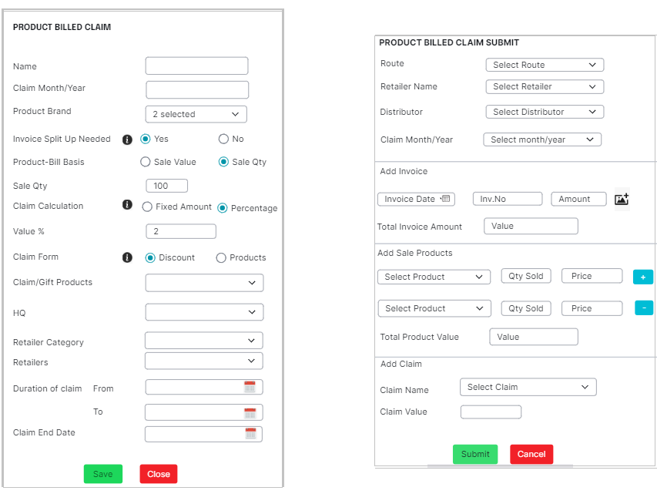
Reference Image - Claim Form -Discount:

Slide 21
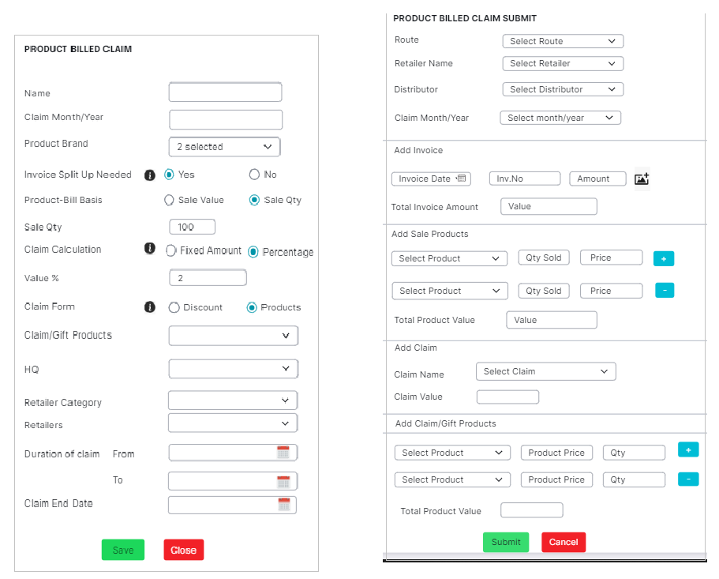
Reference Image - Claim Form - Products:

Slide 22
8. Submit & Close – Buttons
Objective - To save and close the claim submission screen respectively.
Functions:
When “Submit ” button is clicked, it should submit the claim.
When “Close” button is clicked,it should close the claim entry window.
Validations:
Should allow to submit claim only after all mandatory fields are filled and the invoice images are attached.
Should not allow to submit claim if the total claim/git product value is greater than the total invoice value.
Regression Note:
The submitted claim should be shown in the claim status report.

